Slide 1
Student Habits & Performance Analysis
A Machine Learning Regression Project

Slide 2
Objective
To build a machine learning model that predicts a student's exam score based on their daily habits, health indicators, and demographic information.
This can help education and policy-markers identify key life style factors that influence academic success.

Slide 3
Dataset Summary
Total Records : 1000 students
Target Variable : Exam score (continues,range:18.4 to 100.0)
Feature Categories :
Demographics : Age, Gender, Parental education level.
Lifestyle & Habits :
Study : study hours per day, Attendance percentage.
Distractions : Social media hours, Netflix hours
Wellness : Sleep hours, Diet quality, Exercise Frequency, Mental health rating.
Environment : Internet quality, Part time job, Extracurricular participation.

Slide 4
Dataset Features
Numerical:
Study hours per day, Sleep hours, Social media hours, Netflix hours, Exam score.
Categorical:
Gender, Diet quality, Parental education level, Internet quality, Part time job, Extracurricular participation.

Slide 5
Expected Outcome
A predict model that estimates a student's exam score.
Actionable insights about which daily habits improve or hinder academic performance.
A ranked list of lifestyle factors based on their influence on performance.

Slide 6
Project Steps
Import Libraries.
Load dataset.
Data Pre-processing.
Exploratory Data Analysis(EDA).
Scale the Feature.
Build and Train the Linear Model.
Conclusion.

Slide 7
Exploratory Data Analysis
Exploratory Data Analysis (EDA) is the process of analyzing datasets to summarize their main characteristics, often using visual methods.
Key Steps:
Understand the structure of your data
Detect outliers or anomalies
Uncover patterns, trends, and relationships
Test assumptions
Guide further analysis or model building

Slide 8
WORKFL0W OF Exploratory Data Analysis
1. Understand Your Dataset.
2. Univariate Analysis.
3. Target Variable Analysis.
4. Bivariate Analysis.
5. Multivariate Analysis.
6. Missing Data and Outliers.
7. Feature Engineering.
8. Data Imbalance & Sampling.

Slide 9
Model Building
Steps:
1. Label Encoding for categorical variables.
2. Train-Test Split (80/20).
3. Feature Scaling with Standard Scaler.
4. Linear Regression Model.

Slide 10
Model Evaluation
Linear Regression Performance:
- RMSE: 5.14
- MAE: 4.18
- R² Score: 0.897
Conclusion:
Multiple Linear Regression gave the best result compared to other models (Random Forest Regression,Support vector Regression(SVR),Decision Tree Regression).

Slide 11

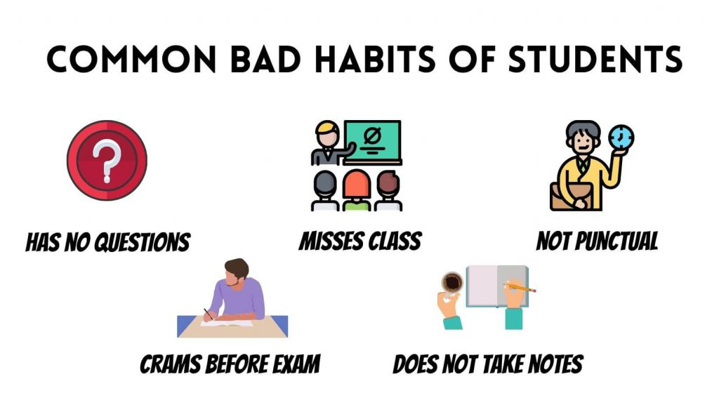
Key Insights
Higher study hours and better sleep quality correlate with higher exam scores.
Social media and Netflix usage negatively impact performance.
Parental education and diet quality also play important roles.

Slide 12
THANK YOU

